Slide 1
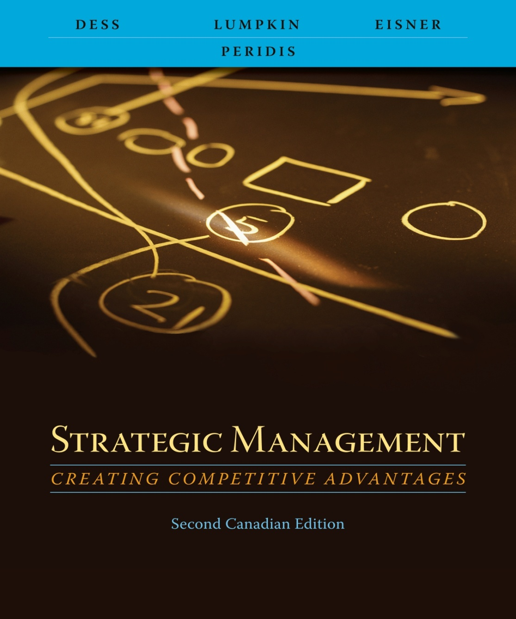
Chapter 11
Strategic Leadership: Creating a Learning Organization and an Ethical Organization

Slide 2
Learning Objectives
After reading this chapter, you should have a good understanding of:
  The three key activities in which all successful leaders must be continually engaged.
  The importance of recognizing the interdependence of the three key leadership activities, and the power in overcoming resistance to change.
  The crucial role of emotional intelligence (EI) in successful leadership.
  The value of creating and maintaining a “learning organization” in today’s global market place.
  The importance of ethics in organizations and a leader’s role in establishing an ethical organization
Copyright © 2009 McGraw-Hill Ryerson Limited 11- <number>.

Slide 3
Leadership
Leadership is the:
process of transforming organizations from what they are to what the leader would have them become
Leadership should be
  Proactive
  Goal-oriented
  Focused on the creation and implementation of a creative vision
Copyright © 2009 McGraw-Hill Ryerson Limited .11-<number>

Slide 4
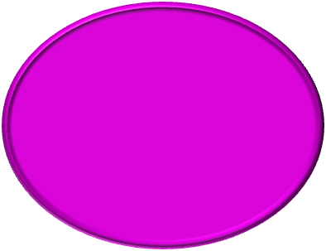


Leadership: Three
Interdependent Activities
Successful leaders
must recognize
three interdependent
activities
2
Designing the
organization
1
Determining a
direction
3
Nurturing a
culture
Adapted from Exhibit 11.1 Three Interdependent Activities of Leadership
Copyright © 2009 McGraw-Hill Ryerson Limited .11-<number>

Slide 5
Determining a Direction
Scan environment to develop
  knowledge of all stakeholders
  Knowledge of salient environmental trends and events
Integrate that knowledge into a vision of what the organization could become
Required capacities
  Solve increasingly complex problems
  Be proactive in approach
  Develop viable strategic options
Copyright © 2009 McGraw-Hill Ryerson Limited .11-<number>

Slide 6
Designing the Organization
Difficulties in implementing the leaders’ vision and strategies
  Lack of understanding of responsibility and accountability among managers
  Reward systems that do not motivate individuals and groups toward desired organizational goals
  Inadequate or inappropriate budgeting and control systems
  Insufficient mechanisms to coordinate and integrate activities across the organization
Copyright © 2009 McGraw-Hill Ryerson Limited .11-<number>

Slide 7
Nurturing a Culture
In nurturing a culture dedicated to excellence and ethical behaviour, managers and top executives must
  Accept personal responsibility for developing and strengthening ethical behaviour
  Consistently demonstrate that such behaviour is central to the vision and mission
  Develop and reinforce
    Role models
    Corporate credos
    Codes of conduct
    Reward and evaluation systems
    Policies and procedures
Copyright © 2009 McGraw-Hill Ryerson Limited .11-<number>

Slide 8
Overcoming Barriers to Change and the Effective Use of Power
Reasons why organizations and managers at all levels are prone to inertia and slow to learn, adapt, and change
  Vested interests in the status quo
  Systemic barriers
  Behavioural barriers
  Political barriers
  Personal time constraints
Copyright © 2009 McGraw-Hill Ryerson Limited .11-<number>

Slide 9









A Leader’s Bases of Power
Exhibit 11.2 A Leader’s Bases of Power
Copyright © 2009 McGraw-Hill Ryerson Limited .11-<number>

Slide 10
Emotional Intelligence: A Key Leadership Trait
Successful traits of leaders at the highest level
Technical skills
Cognitive abilities
Emotional intelligence
Accounting, business planning, etc.
Ability to work with others, passion for work, etc.
Analytical reasoning, quantitative analysis, etc.
Copyright © 2009 McGraw-Hill Ryerson Limited .11-<number>

Slide 11
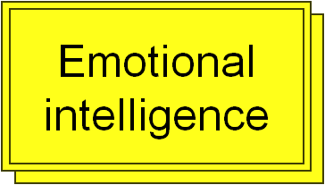
Emotional Intelligence
Five components of emotional intelligence
  Self-awareness
  Self-regulation
  Motivation
  Empathy
  Social skill
Copyright © 2009 McGraw-Hill Ryerson Limited .11-<number>

Slide 12
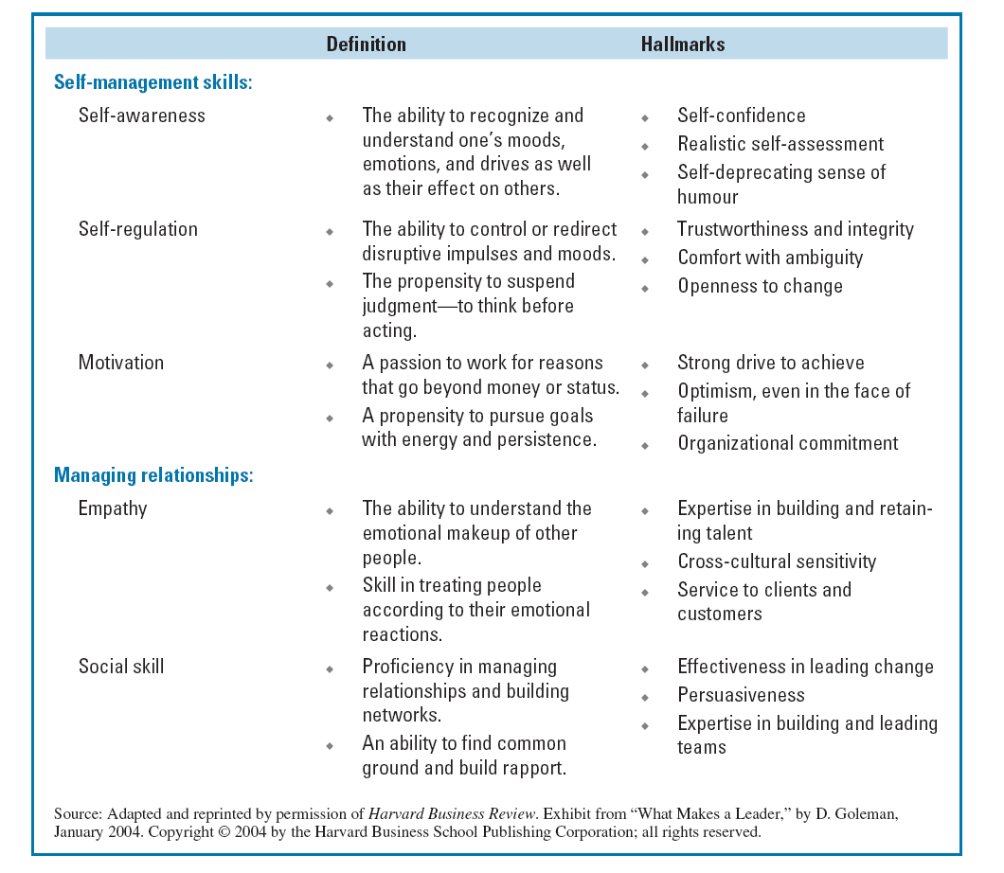
Copyright © 2009 McGraw-Hill Ryerson Limited .11-<number>

Slide 13
Developing a Learning Organization
Successful learning organizations
  Create a proactive, creative approach to the unknown
  Actively solicit the involvement of employees at all levels
  Enable all employees to use their intelligence and apply their imagination
Copyright © 2009 McGraw-Hill Ryerson Limited .11-<number>

Slide 14
Developing a Learning Organization
Learning environment
  Organization-wide commitment to change
  An action orientation
  Applicable tools and methods
  Guiding philosophy
  Inspired and motivated people with a purpose
Copyright © 2009 McGraw-Hill Ryerson Limited .11-<number>

Slide 15
Four Critical Processes of Learning Organizations
Salient elements of empowerment
  Start at the bottom by understanding needs of employees
  Teach employees skills of self-management
  Build teams to encourage cooperative behaviour
  Encourage intelligent risk taking
  Trust people to perform
1
Empowering employees at all levels
Copyright © 2009 McGraw-Hill Ryerson Limited .11-<number>

Slide 16
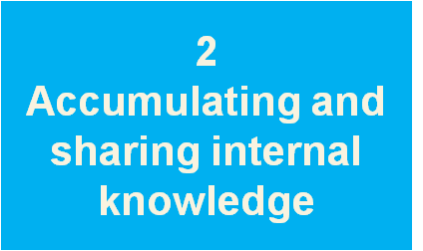
Four Critical Processes of Learning Organizations
“Open book” management
  Numbers on each employee’s work performance and production costs generated daily
  Information is aggregated once a week from top level to bottom level
  Extensive training in how to use and interpret the numbers—how to understand balance sheets, cash flows and income statements
Copyright © 2009 McGraw-Hill Ryerson Limited .11-<number>

Slide 17
Four Critical Processes of Learning Organizations
Awareness of environmental trends and events
  Internet accelerates the speed with which useful information can be located
  “Garden variety” traditional sources for acquisition of external information
  Benchmarking
  Focus directly on customers for information
3
Gathering and integrating external information
Copyright © 2009 McGraw-Hill Ryerson Limited .11-<number>

Slide 18
Four Critical Processes of Learning Organizations
Challenging the status quo
  Create a sense of urgency
  Establish a “culture of dissent”
  Foster a culture that encourages risk taking
  Cultivate culture of experimentation and curiosity
4
Challenging the status quo and enabling creativity
Copyright © 2009 McGraw-Hill Ryerson Limited .11-<number>

Slide 19
Creating An Ethical Organization
Organizational ethics is a direct reflection of its leadership
Unethical business practices
  Involves tacit, if not explicit, cooperation of others
  Reflect the values, attitudes, and behaviour pattern that define the organization’s operating culture
Copyright © 2009 McGraw-Hill Ryerson Limited .11-<number>

Slide 20
Creating An Ethical Organization
Driving forces of ethical organizations
  ethical values
  Integrity
Ethical values
  Shape the search for opportunities
  Shape the design organizational systems
  Shape the decision-making process used by individuals and groups
  Provide a common frame of reference that serves as unifying force
Copyright © 2009 McGraw-Hill Ryerson Limited .11-<number>

Slide 21
Integrity-Based versus Compliance-Based Approaches to
Organizational Ethics
Essential links between organizational integrity and individual integrity
  Cannot have high-integrity organizations without high-integrity individuals
  Individual integrity is rarely self-sustaining
  Organizational integrity is beyond personal integrity, resting on a concept of
    Purpose
    Responsibility
    ideals
Copyright © 2009 McGraw-Hill Ryerson Limited .11-<number>

Slide 22
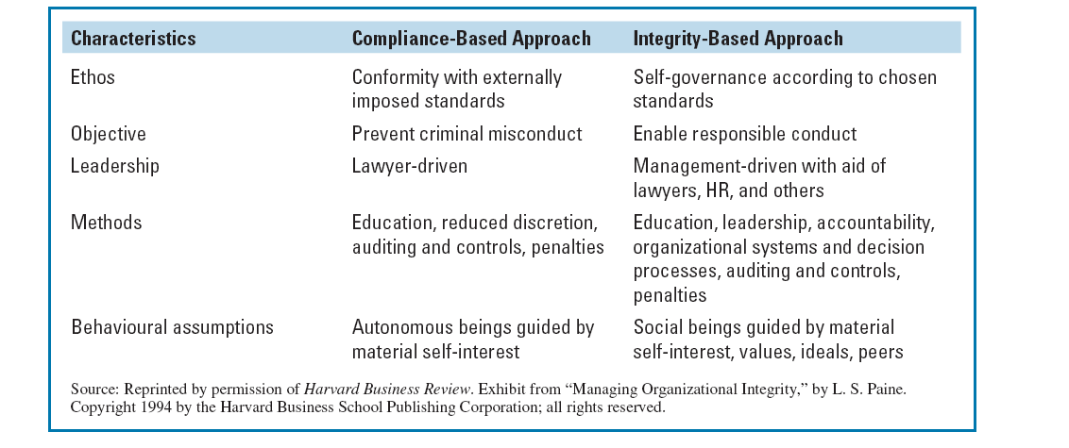
Copyright © 2009 McGraw-Hill Ryerson Limited .11-<number>

Slide 23
Key Elements of Highly Ethical Organizations
These interrelated elements must be present and constantly reinforced
  Role models
  Corporate credos and codes of conduct
  Reward and evaluation systems
  Policies and procedures
Copyright © 2009 McGraw-Hill Ryerson Limited .11-<number>

Slide 24
4 Key Elements of Highly Ethical Organizations
1 Role models
2 Corporate credos and codes of conduct
Leaders are role models for their organizations
Leaders must be consistent in their words and deeds
Values and character of leaders become transparent to an organization’s employees
Effective leaders take responsibility for ethical lapses within the organization
Provide a statement and guidelines for norms, beliefs and decision making
Provide employees with clear understanding of the organization’s position regarding employee behaviour
Provide the basis for employees to refuse to commit unethical acts
Contents of credos and codes of conduct must be known to employees
Copyright © 2009 McGraw-Hill Ryerson Limited .11-<number>

Slide 25
4 Key Elements of Highly Ethical Organizations
3 Reward and evaluation
systems
4 Policies and procedures
Inappropriate reward systems may cause individuals at all levels of the organization to commit unethical acts that they might not otherwise do
Penalties in terms of damage to reputations, human capital erosion, and financial loss are typically much higher than any gains that could be obtained through such unethical behaviour
Policies and procedures can specify proper relationships with a firm’s customers and suppliers
Policies and procedures can guide employees to behaviour ethically
Policies and procedures must be reinforced
  Effective communication
  Enforcement
  Monitoring
  Sound corporate governance practices
Copyright © 2009 McGraw-Hill Ryerson Limited .11-<number>

